Slide 1
Payroll vs Performance: Examining Team Success in U.S. Sports Leagues
By: Sam Bunten and Matt Thurston

Slide 2
Research Question
What off-field factors impact a team's success?

Slide 3

Problem
Different cap rules between the big 4 leagues
  NBA has a soft cap with a luxury tax penalty
  MLB has no salary cap
  NFL has a hard cap. Can't exceed otherwise face severe penalties
  NHL has a hard cap
These differences provide competitive advantages
Typically, larger cities or bigger markets do better
Richer owners can spend more in some circumstances
All of these combined cause fans to become annoyed with the lack of consistency in American sports

Slide 4

Data Collection
Salary and team cap information is widely available due to their league wide importance
We scraped data from Spotrac
  Largest sports team and player contract resource online
We scraped from the 2025 season down to the 2015 season
Collected information on the various cap statistics per team
Collected the 100 highest paid players per year per team
This left us with 8 total data sets

Slide 5
Approach
After collection, we had to clean the datasets
A lot of the leagues had unnecessary data that we had to cut
  Examples: Duplicate team name columns and row of totals,
The scraping only provided us with a team's record
  We had to convert this into win percentage for analysis
After we cleaned the data, we calculated correlation coefficients to gain a better understanding on the relationship between spending and wins
We also wanted to create initial visualizations to help guide our future analysis

Slide 6
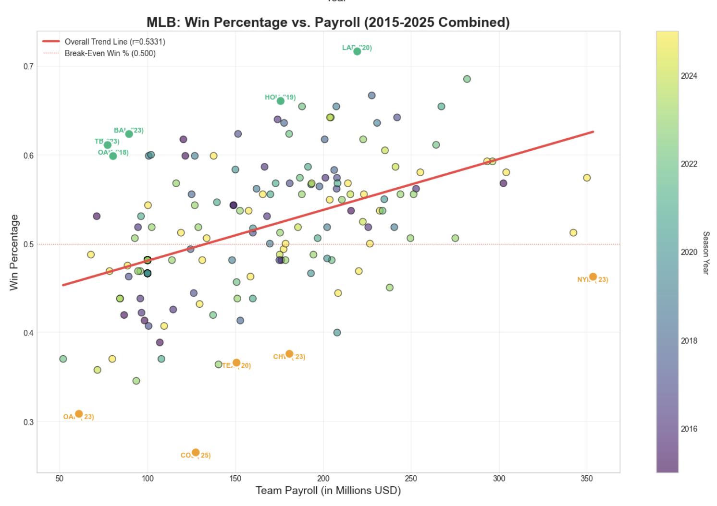
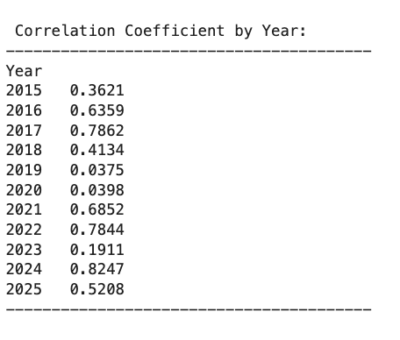
Exploratory Data Analysis for MLB

Slide 7
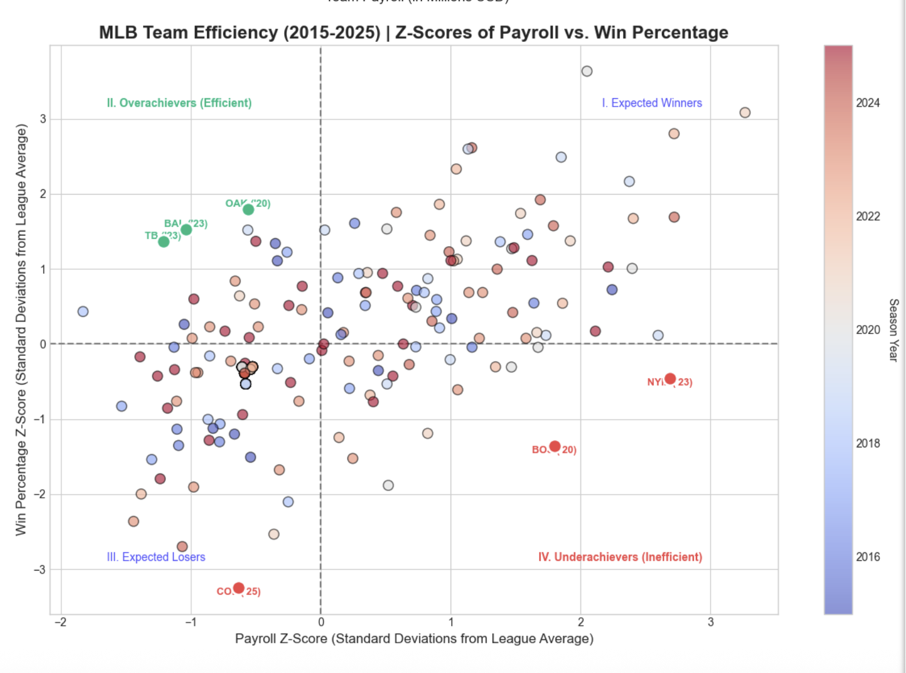
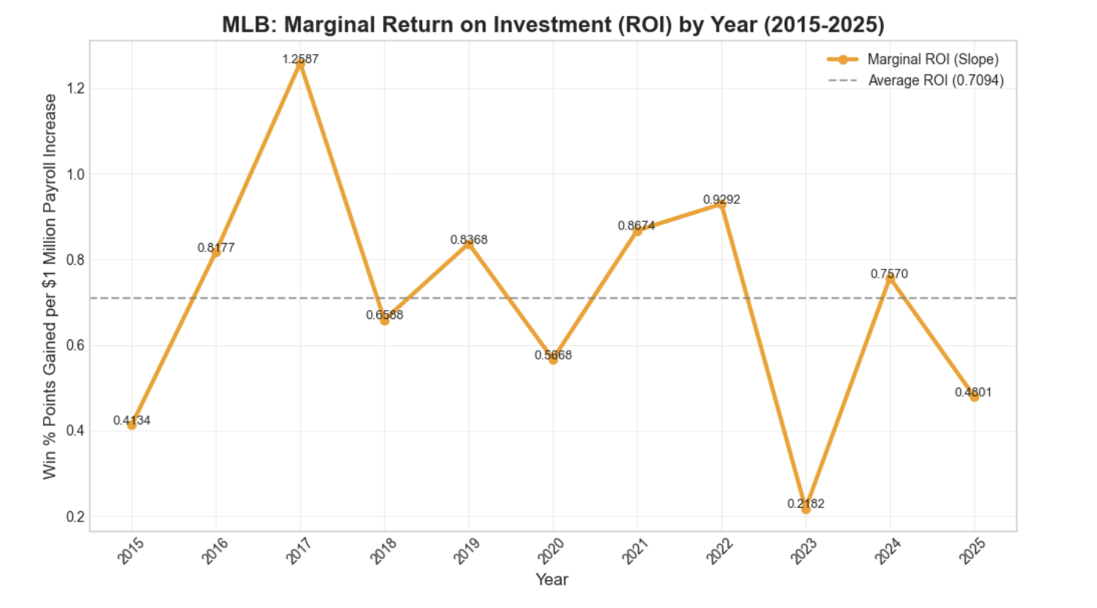
Exploratory Analysis for MLB

Slide 8
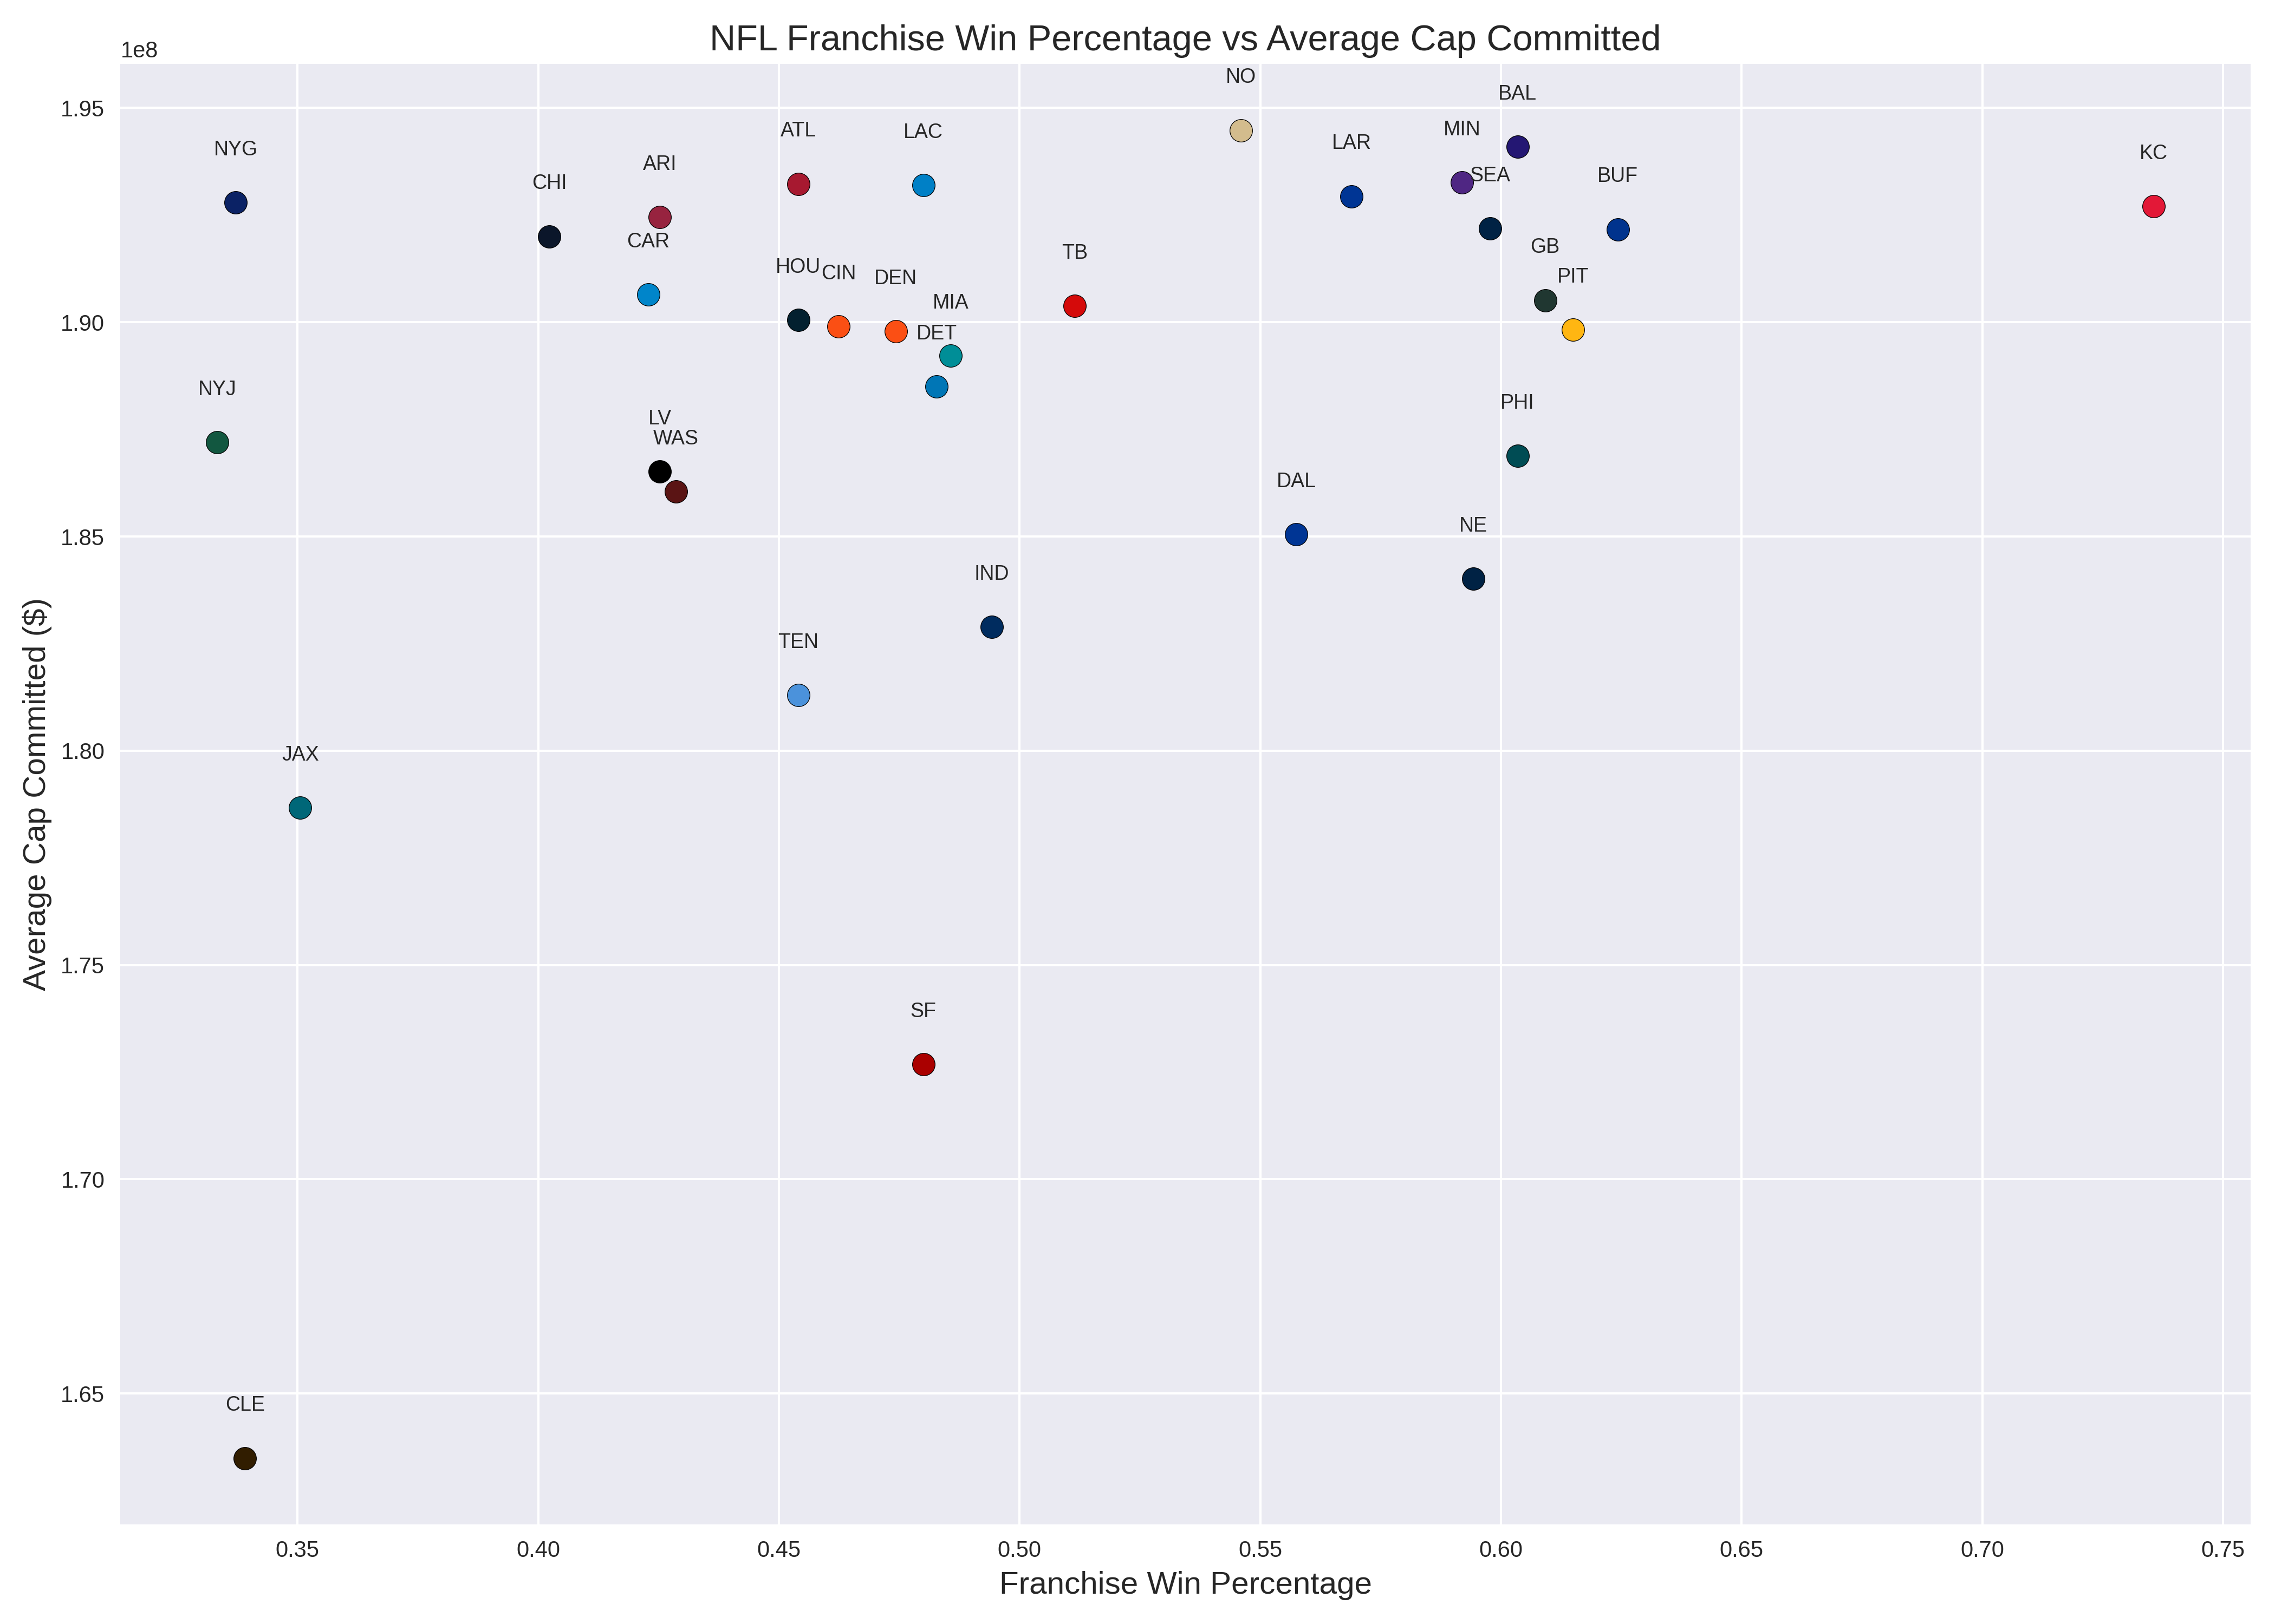
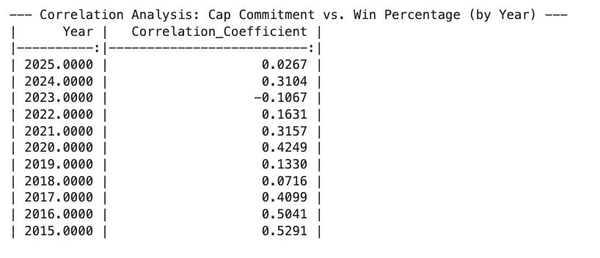
Exploratory Analysis for NFL

Slide 9
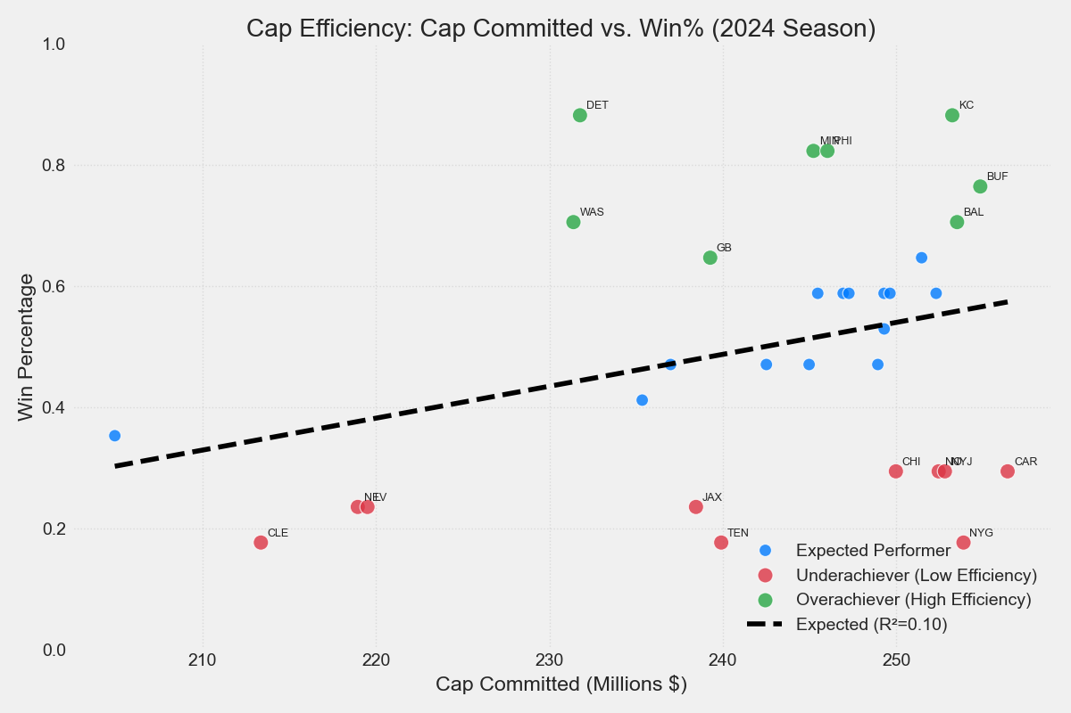
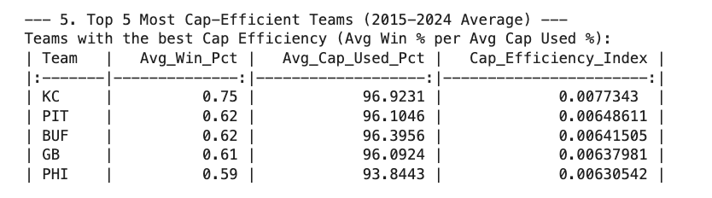
Exploratory Analysis for NFL

Slide 10
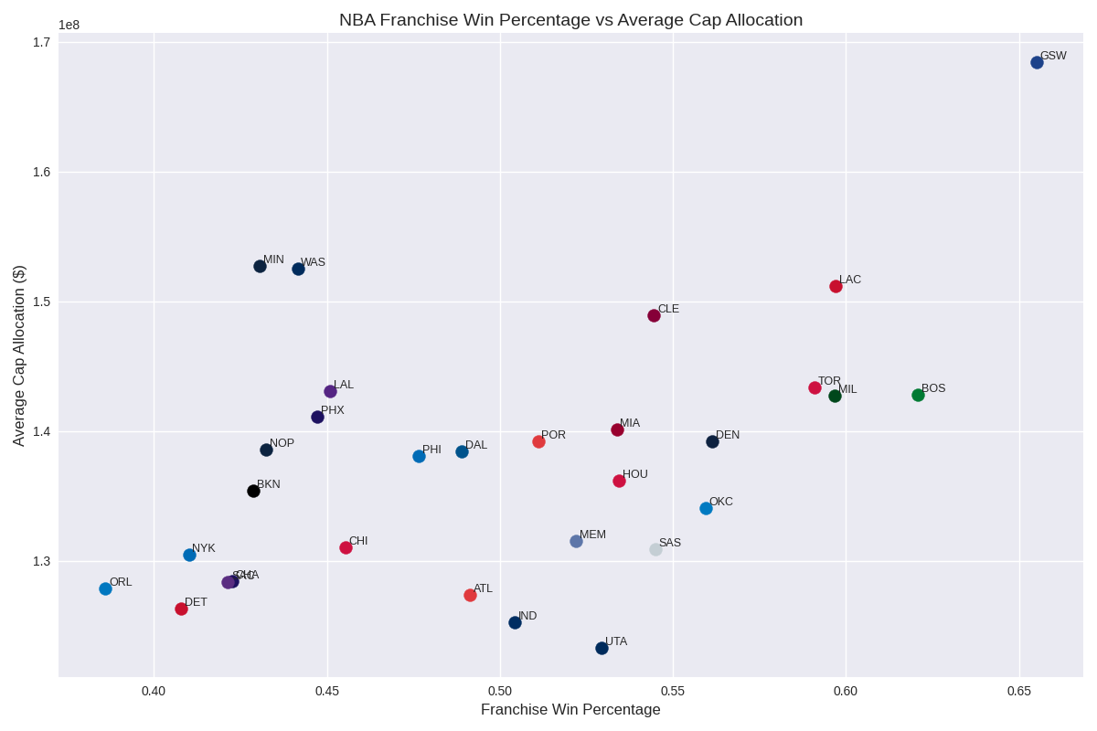
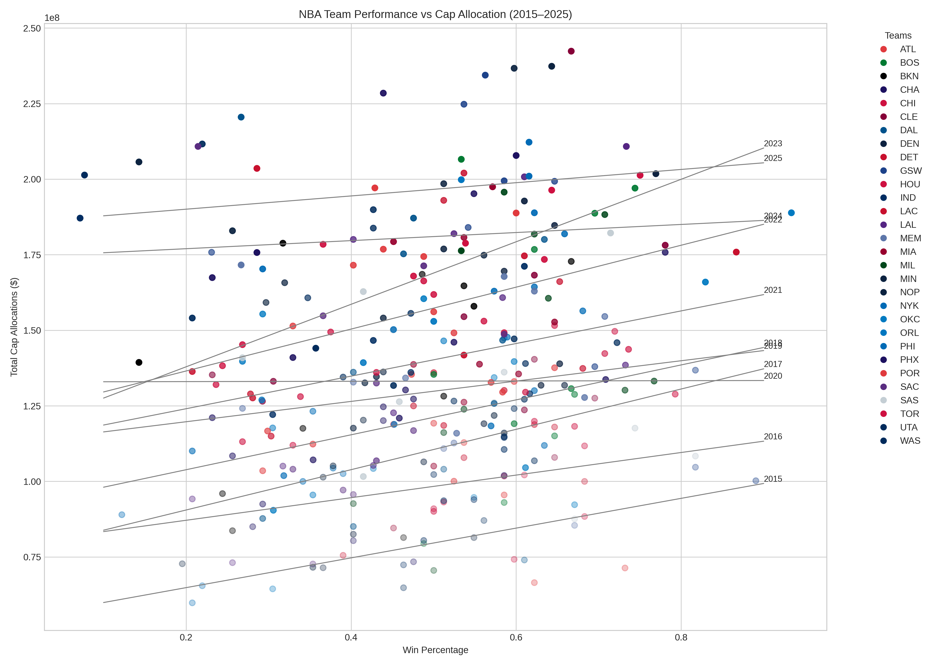
Exploratory Analysis for NBA
Correlation (Wins vs. Cap Allocations)
2015: .42 2021: .33
2016: .51 2022: .41
2017: .47 2023: .36
2018: .39 2024: .49
2019: .44 2025: .31
2020: .28

Slide 11
Implications
Owners would want to look at our data to understand what could be the optimal amount to spend on a team
Players would like to see this information during contract discussion
  For example: Some players take a pay cut to improve odds of winning
Are the highest paid players the ones driving their team's performance or is it the underpaid ones

Slide 12
Ethics
Unfair Advantages: League structure differences allows different owners and markets to dominate over time
Fan Frustration: Fans are becoming annoyed with "super teams" and losing players to larger markets
Sporting Integrity: Why would fans watch if results are too easily predicted by spending
Are leagues taking advantage of their players or on the flip side, paying them too much

Slide 13
Extensions and Future Plans
Expand to more players per league
Include more variables like population of the city
Look at average age of a team
Goal: Create a linear regression for each league and see what variables impact the number of wins that a team has in any given season

Slide 14
Conclusion
Payroll and cap information for a team clearly has a relationship with win percentage
Other factors are at play though
We need to look into and research more off the field variables that could be impacting it
Sports analytics is already huge within the leagues themselves, but this form of analysis isn't typically available to the average fan

